Slide 1
Tacos KFT.

Slide 2

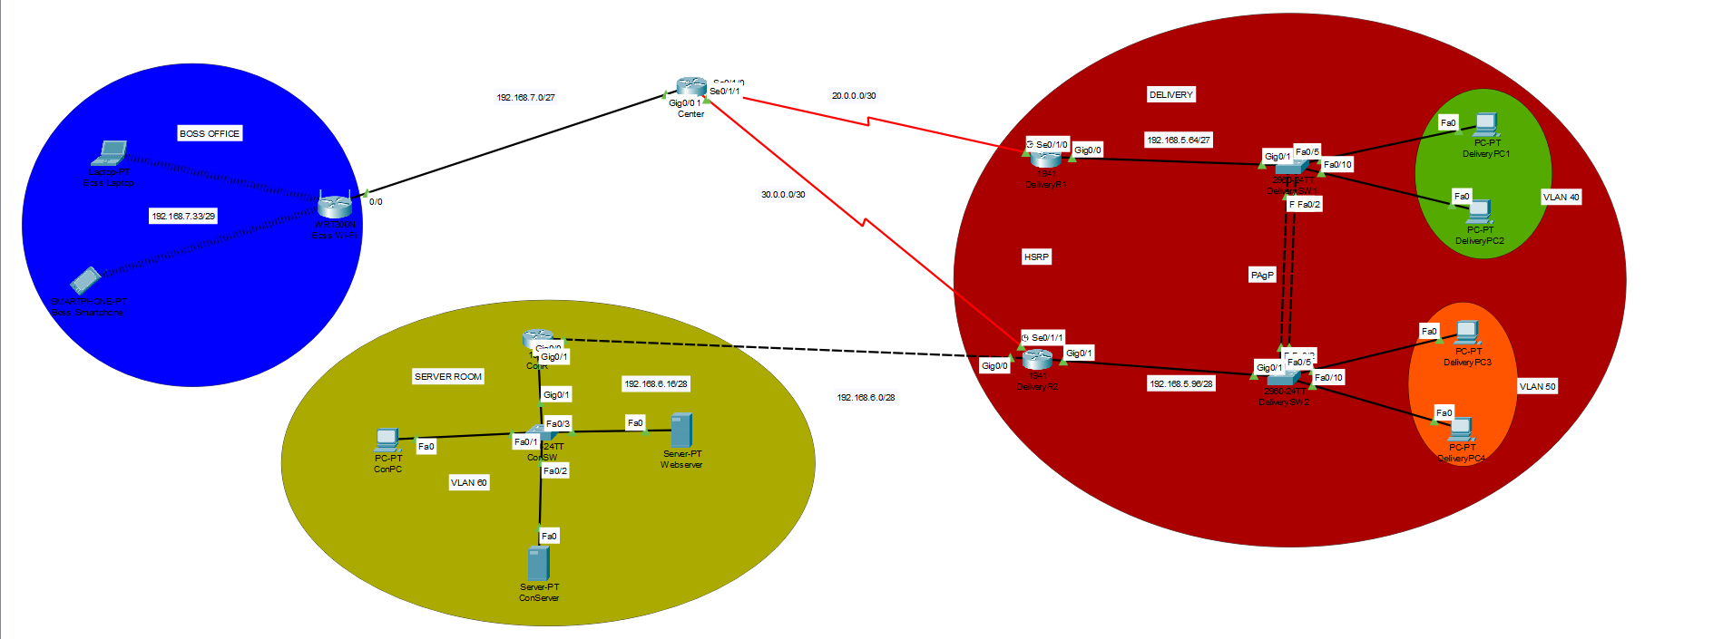



Topológia

Slide 3
IP/IPV6 tábla
Eszköz | Interface | IP | IPv6 | Subnet | Gateway
Center | Gig/0/0 Se0/1/0 Se0/1/1 | 192.168.7.1 20.0.0.1 30.0.0.1 | --------------------------------------------------------------------------------------------- | /27 /30 /30 | --------------------------------------------------------------------------------------------
Delivery R1 | Gig0/0.40 Se0/1/0 | 192.168.5.65 20.0.0.2 | 2001:ACAD:DB8:5::2/64 ------------------------------- | /27 /30 | ---------------------------------------------------------------------
Delivery R2 | Gig0/0.50 Se0/1/0 | 192.168.5.97 30.0.0.2 | 2001:ACAD:DB8:5::1/64 ------------------------------- | /28 /30 | ---------------------------------------------------------------------
ConR | Gig0/0 Gig0/1.60 | 192.168.6.2 192.168.6.17 | -------------------------------------------------------------- | /28 /28 | ---------------------------------------------------------------------
Boss Wi-Fi | Internet LAN | 192.168.7.2 192.168.7.33 | --------------------------------------------------------------------------------- | /29 /29 | 192.168.7.1
DeliverySW1 | VLAN 40 | ------------------------ | -------------- | --------- | ----------------------------------------------
DeliverySW2 | VLAN 50 | ------------------------ | -------------- | --------- | -----------------------
DeliveryPC1 | NIC | DHCP | SLAAC | /27 | 192.168.5.65
DeliveryPC2 | NIC | DHCP | SLAAC | /27 | 192.168.5.65
DeliveryPC3 | NIC | DCHP | SLAAC | /28 | 192.168.5.97
DeliveryPC4 | NIC | DHCP | SLAAC | /28 | 192.168.5.97
DeliveryServer | NIC | DHCP | SLAAC | /27 | 192.168.5.85
Laptop | Wireless | DHCP | -------------- | /29 | 192.168.7.1
Smartphone | Wireless | DHCP | -------------- | /29 | 192.168.7.1
ConPC | NIC | 192.168.6.20 | Stateful | /28 | 192.168.6.17
ConServer | NIC | 192.168.6.25 | 2001:ACAD:DB8:6::1/64 | /28 | 192.168.6.17

Slide 4
Vlan tábla
Eszköz neve | Azonosító | Név | Portok | Hálózat
DeliverySW1 | 40 99 | Delivery1 Trash | Fa0/5,Fa0/10,Fa0/3 | 192.168.5.64/27
DeliverySW2 | 50 99 | Delivery2 Trash | Fa0/5,Fa0/10 | 192.168.5.96/28
ConSW | 60 99 | ConVLAN Trash | Fa0/1, Fa0/2 | 192.168.6.16/28

Slide 5
Etherchannel
Protokoll | Port
PAgP | Fa0/1, Fa0/2
PAgP | Fa0/1, Fa0/2

Slide 6

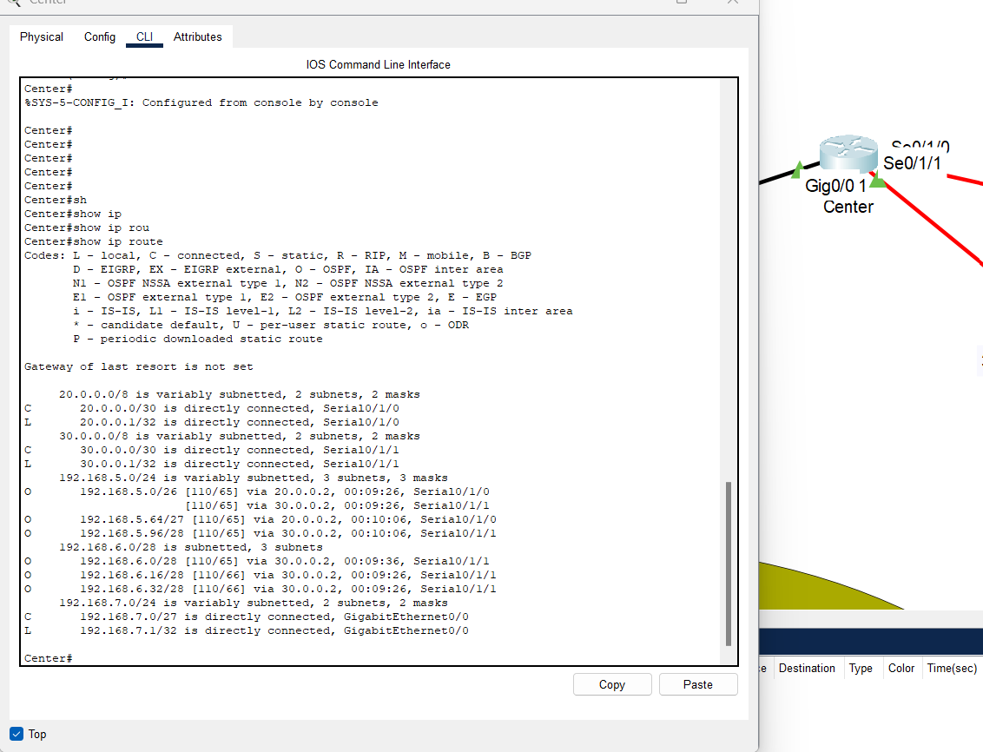
Route Table

Slide 7
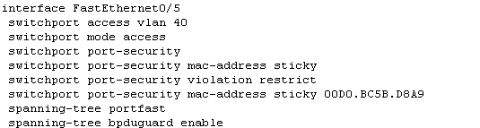
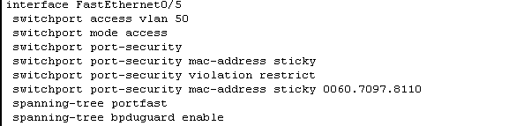
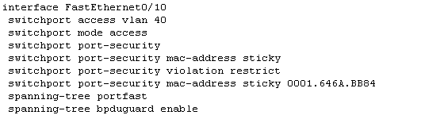
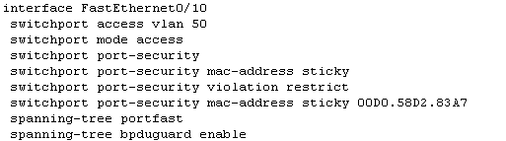
Port-Security,(BPDU Guard)
Delivery SW1
Delivery SW2

Slide 8
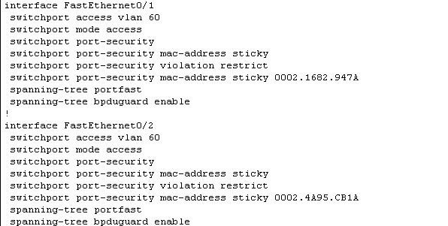
Port-Security,(BPDU Guard)

Slide 9
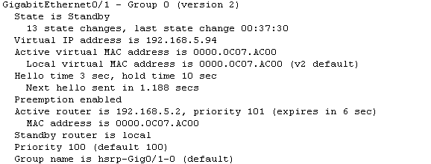
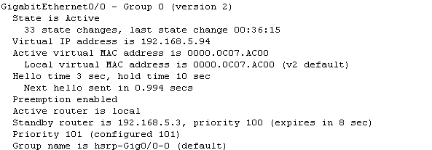
HSRP
DeliveryR1
DeliveryR2

Slide 10

ASA

Slide 11
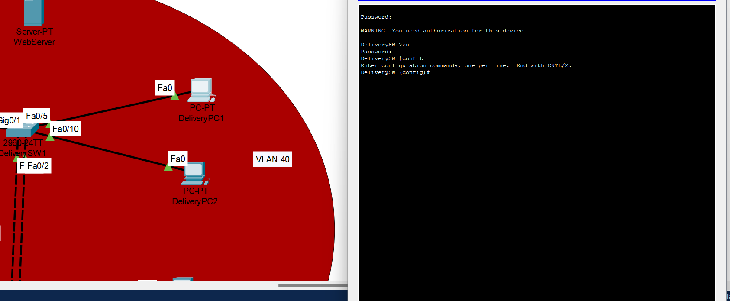
SSH

Slide 12
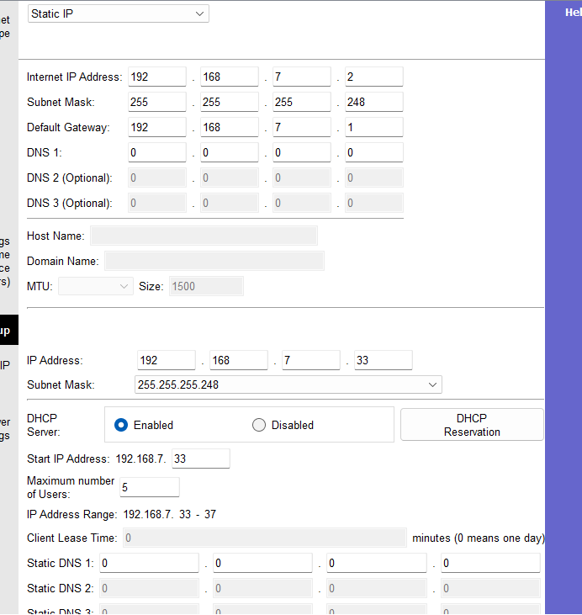
WIFI

Slide 13
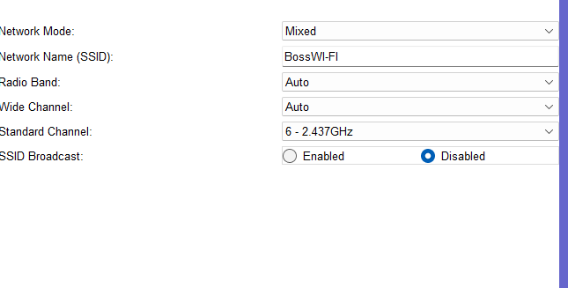
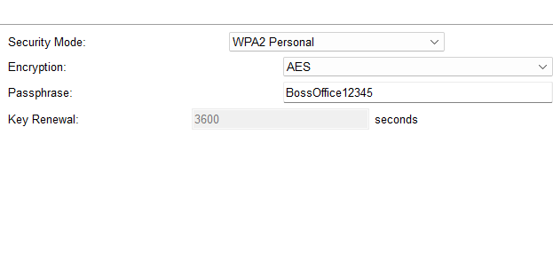
WIFI Security

Slide 14
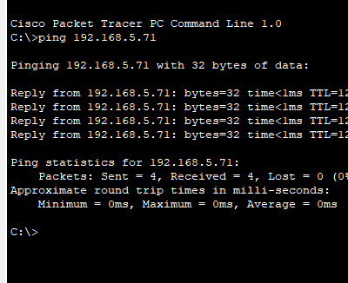
Ping (Vlan 60 Vlan 40)

